Slide 1
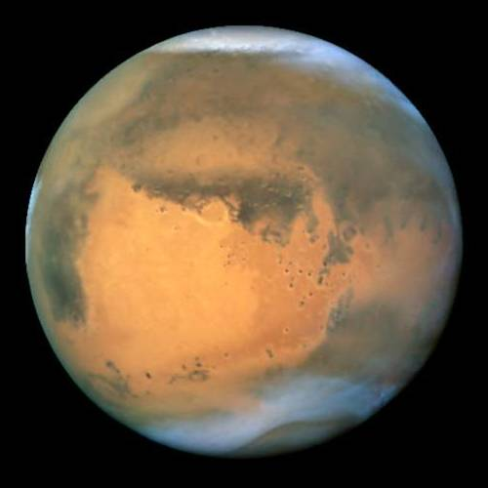
OBSERVING MARS 2018
Mars (god of war)
Nirgal (star of death)
Angakara (burning coal)
Huoxing (fire star)
A DROP OF CURDLED BLOOD IN THE NIGHT SKY

Slide 2
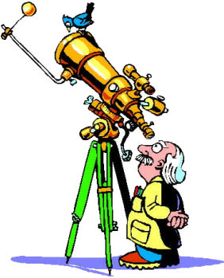
Liability Warning Be careful Observing Mars!
Beware the ire of Mars, astrologers say
“Expect heated aggression, flashes of road rage and fiery embraces of passion”, warn astrologers, “as Mars moves closer to the Earth….”

Slide 3
MARS WEBSITES
Mars Profiler (orientation of Mars 2018): http://wwwcdn.skyandtelescope.com/wp-content/plugins/observing-tools/mars_profiler/mars.html
Mars 2018 Opposition (details): http://www.alpo-astronomy.org/jbeish/2018_MARS.htm
Current Photos of Mars: http://alpo-j.asahikawa-med.ac.jp/Latest/Mars.htm
Richard Orr’s Mars drawings: http://www.orrastrodrawing.com/Mars.html

Slide 4
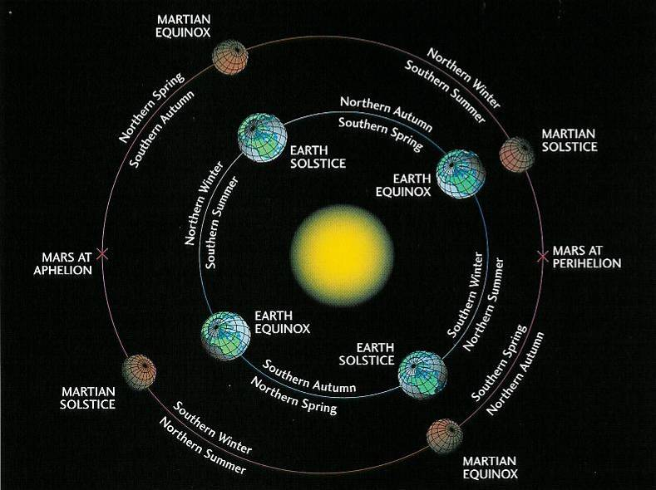
Not all Mars Oppositions are Equal
20% closer to the sun during perihelion (SP cap faces the sun) than at aphelion (NP cap faces the sun)
Southern Summers are 52 days shorter but 64 F warmer (45% more sun) than Summers in the north
From Earth 50% brighter when closest (wheat colored) than furthest (blood red)

Slide 5
The GOOD, the BAD, the UGLY
The Good for 2018:
You can see clouds, dark markings, the south polar cap and surface detail.
Mars gets just about as large as it ever gets exceeding 24” in size between July 23rd and August 9th (this is 97 percent of the maximum of 25.13”). It will not appear this large again for 17 years.
You can observe Mars when the moon is bright and/or transparency is poor. The stability of the atmosphere during our Summer months is often the best we get here in Maryland.
The Bad for 2018:
Mars is placed low in the sky much more so than in most oppositions – but 4.4 degrees higher than the last opposition (2016)
Mars is going to be small, very bright, with its surface markings subtle. It will not appear like the enhanced highly processed photos or even detailed drawings that you have seen.
The Ugly for 2018:
Viewing Mars will be like trying to see details within a medium-sized lunar crater at full moon while the moon is near the horizon -- and the crater is covered in a thick Los Angeles like-smog

Slide 6
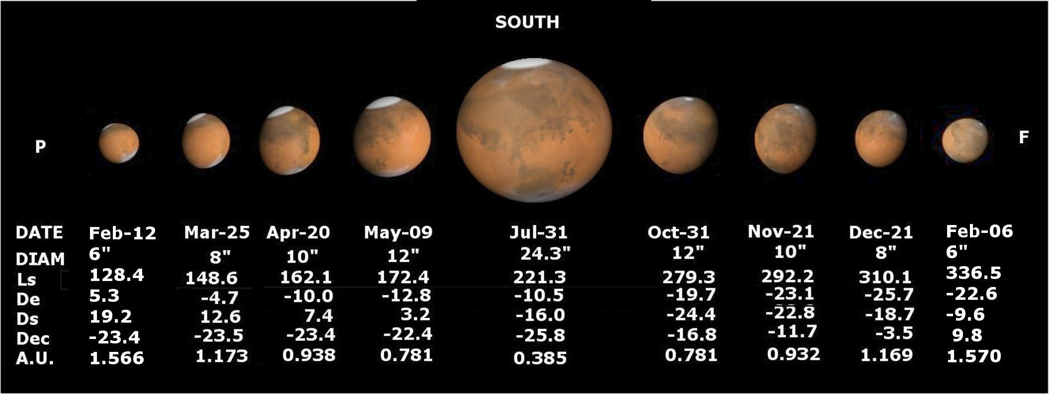
Mars 2018
Mars will reach opposition on July 22nd . At that time it will reach 24.3 arcseconds.
Mars will be closest to Earth on July 31st . It will still be 24.3 arcseconds in size.
Start of Mars autumn (northern) and spring (southern) on May 22nd
Start of Mars winter (northern) and summer (southern) on October 16th

Slide 7
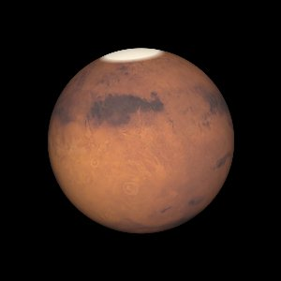
A simulated view of the appearance of Mars during opposition at 0507 UT on July 27, 2018 (218.9° Ls, CM 143.9°)
Notes:
What are we going to see? Next slide.

Slide 8
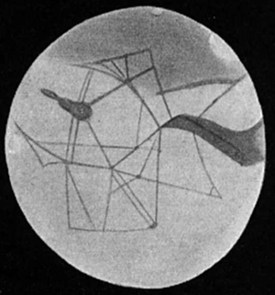
“Nothing is ever seen perfectly, but only by fragments, and under various conditions of obscurity” – John Ruskin

Slide 9
“History has shown that [Mars] has revealed itself only to those who care. We do not expect first-time observers to come away from the eyepiece with a complete understanding of what he or she has seen. Nor do we expect novice observers to see much.”
W. Sheehan & S.J. O’Meara (The Lure of the Red Planet)

Slide 10
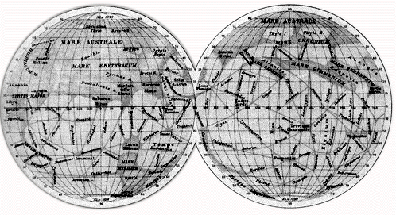
“We may hope that, because the world of Mars is older than ours, humankind there will be more advance and wiser” – Flammarion
“Yet across an immense ethereal gulf, minds that are to our minds as ours are to the beasts in the jungle, intellects vast and cool and unsympathetic regarded this earth with envious eyes and slowly and surely drew their plans against us” – War of the Worlds

Slide 11
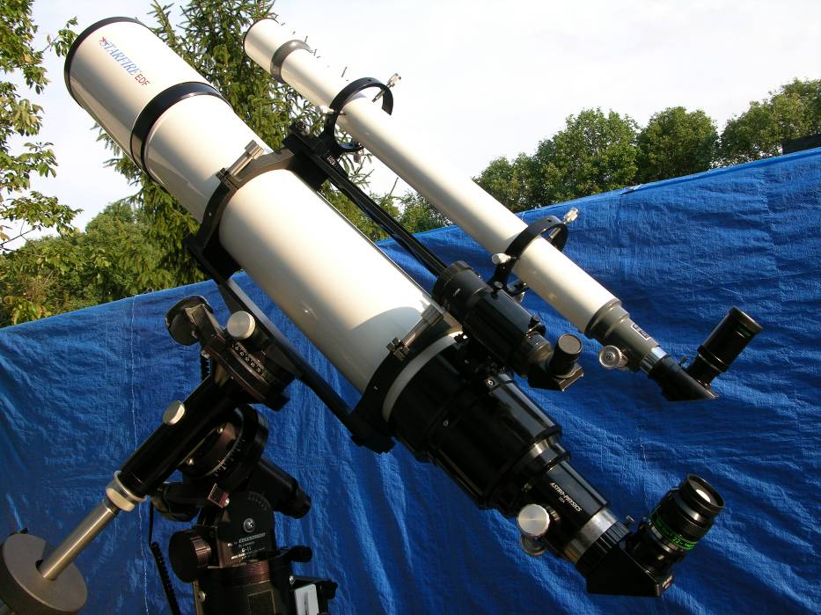
To See Mars at its Best (small bright with subtle markings)
Telescope (quality, size) Your goal is to maximize contrast and resolution
Resolution (Dawes limit) vs. contrast
Dobsonians – collimation is the key
MAK & SCT – watch for tube currents
Trust your telescope – expect to be disappointed in your initial image of Mars
Location of Telescope
High Power (60-75x/inch on 8” or less; on 12” or more 500x) – eyepiece/barlow quality – filter (Mars is too bright)
Mount (high quality drive) and Chair
Patience and Practice
Familiarity with the gross surface markings -- know what to look for on Mars

Slide 12
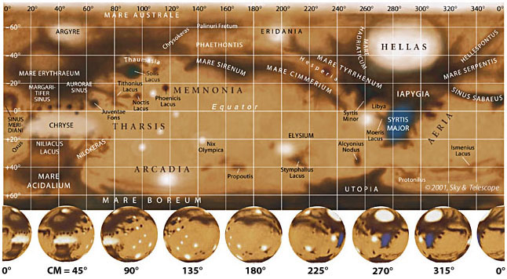
MAP OF MARS
Dark Brown/red Areas = mixed dust sizes or exposed rock
Light Red Areas = lots of fine-grained dust
White Areas = clouds, frost, ice, fog

Slide 13
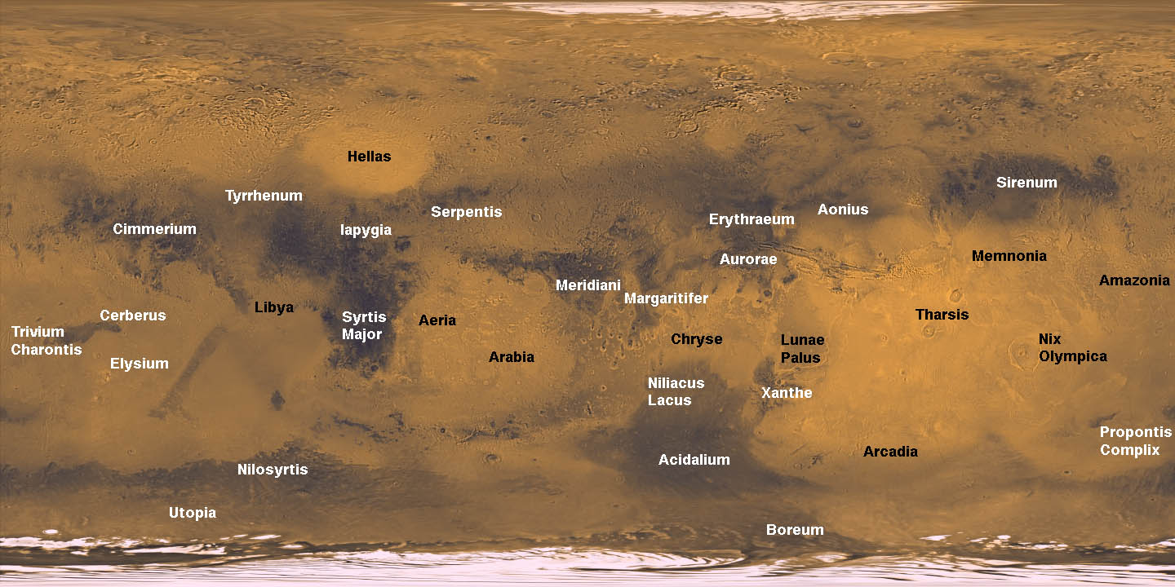
Getting familiar with Mars

Slide 14
Getting familiar with Mars
1) Syrtis Major¹ 7) Sinus Cimmerium⁵
2) Hellas² 8) Sinus Tryrrhenum⁵
3) Sinus Sabaeus 9) Proponitis Complex
4) Sinus Meridiani³ 10) Solis Lacus⁴
5) Utopia 11) Mare Erythraeum
6) Sinus Sirenum⁵ 12) Mare Acidalium
KEY:
1 = means Mediterranean Sea (old names Hourglass Sea, Blue Scorpion, Frasier Sea)
2 = means Greece (largest impact basin in the Solar System)
3 = Dawes’ Forked Bay (zero longitude)
4 = Eye of Mars (Schiaparelli’s “Land of Wonder”)
5 = Schiaparelli’s “Great Diaphragm”

Slide 15
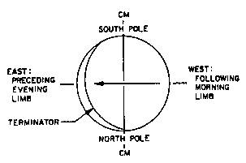
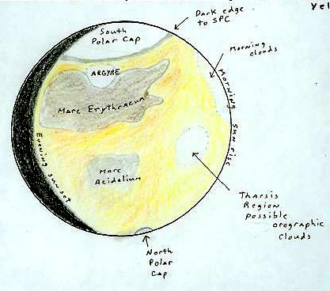
MARS ORIENTATION
Figure out before observing the orientation of Mars & Rotation (sunrise/sunset) for your telescope
Day on Mars = 24 hours, 37 minutes – therefore if you observe the same time night after night the surface features appears to back up (anti-rotational) about 9 degrees every night causing an illusory retrograde rotation of about 36 days.
Polar caps will be offset from the apparent up and down in your eyepiece.

Slide 16
USE OF COLOR FILTERS (a necessity not a choice; even so – improvements are going to be subtle)
Enhances dark Red (W25) for 6” or more
surface markings Yellow (W15) for 5” or less
Atmospheric clouds, limb Blue (W80A)
hazes, polar caps & hoods
Surface frosts and fog Green (W58)
No filter Color of disk and its markings
Specialized Interference filter(s) General overall views
(Note -- Buy 1-1/4” not 2” since you will be changing filters more than changing eyepieces) -- Filter Wheel recommended – but must be of high quality if you are going to use interference filter(s).

Slide 17
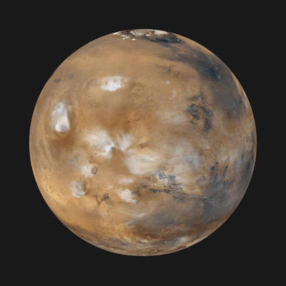
MARTIAN METEOROLOGY
Discrete Atmospheric Clouds
Orographic (Bright in Blue; Faint in Green and Orange) --best seen about two hours before sunset
Localized – e.g. Syrtis Blue Cloud (Best in Blue)
Morning & Evening Clouds (Best in Blue) -- Evening Clouds can be as bright as the polar caps
Limb Brightening
Scattering of Dust (Best in Red)
Scattering of Dry Ice Particles (Best in Blue)
Surface Frosts (Green best -- has sharp edges)
Low level fog or Clouds (Green best --has hazy edges)
Dust Storms (Bright in Red; Faint in Yellow)

Slide 18
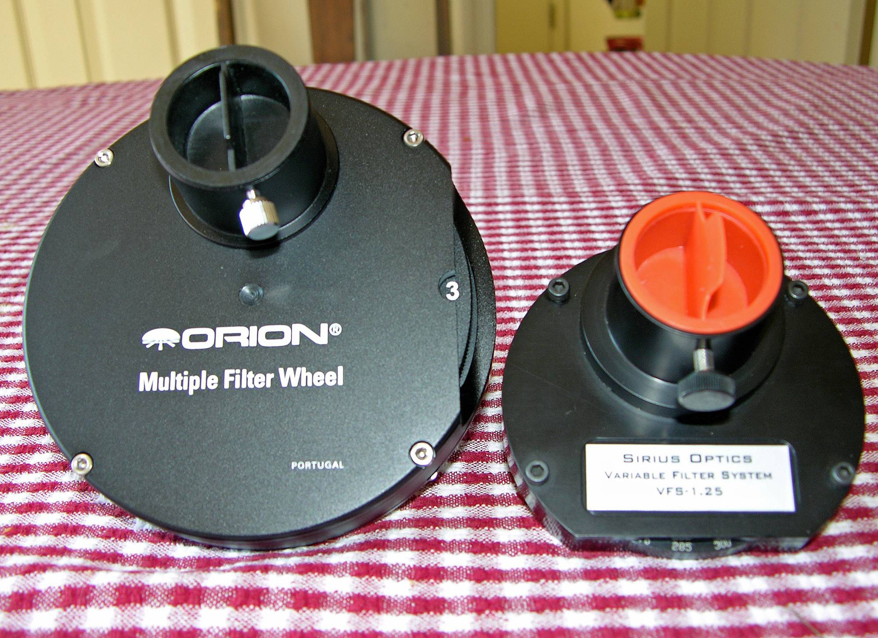

Slide 19
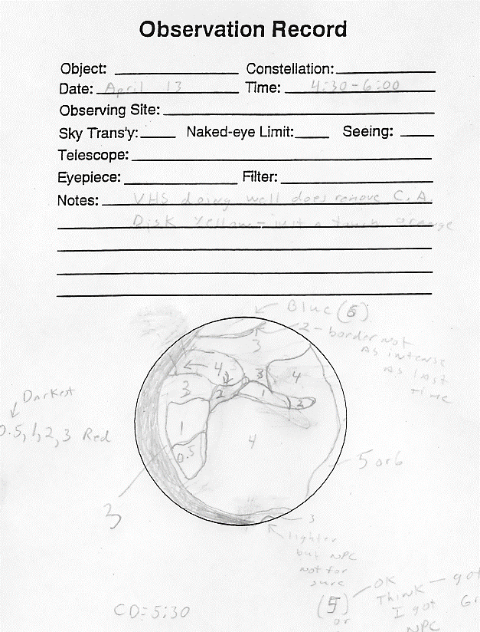
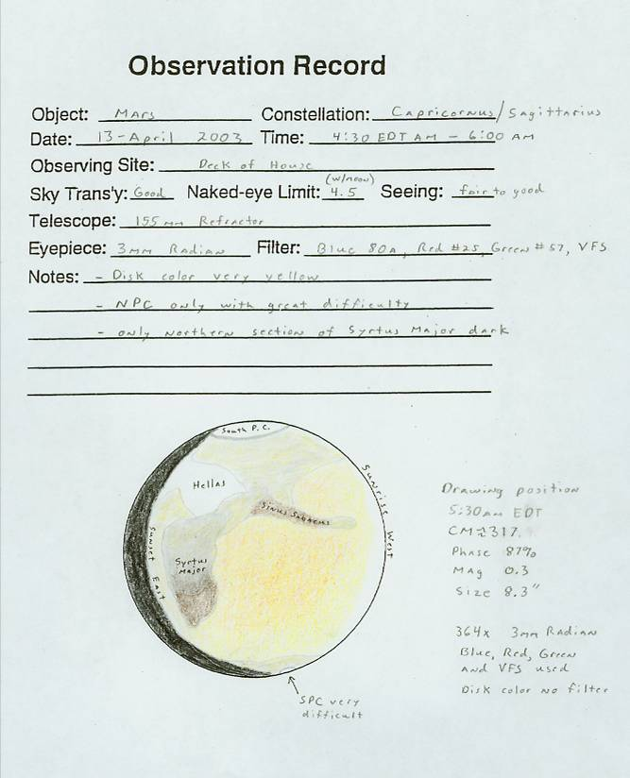
Make a Drawing You will see more detail

Slide 20
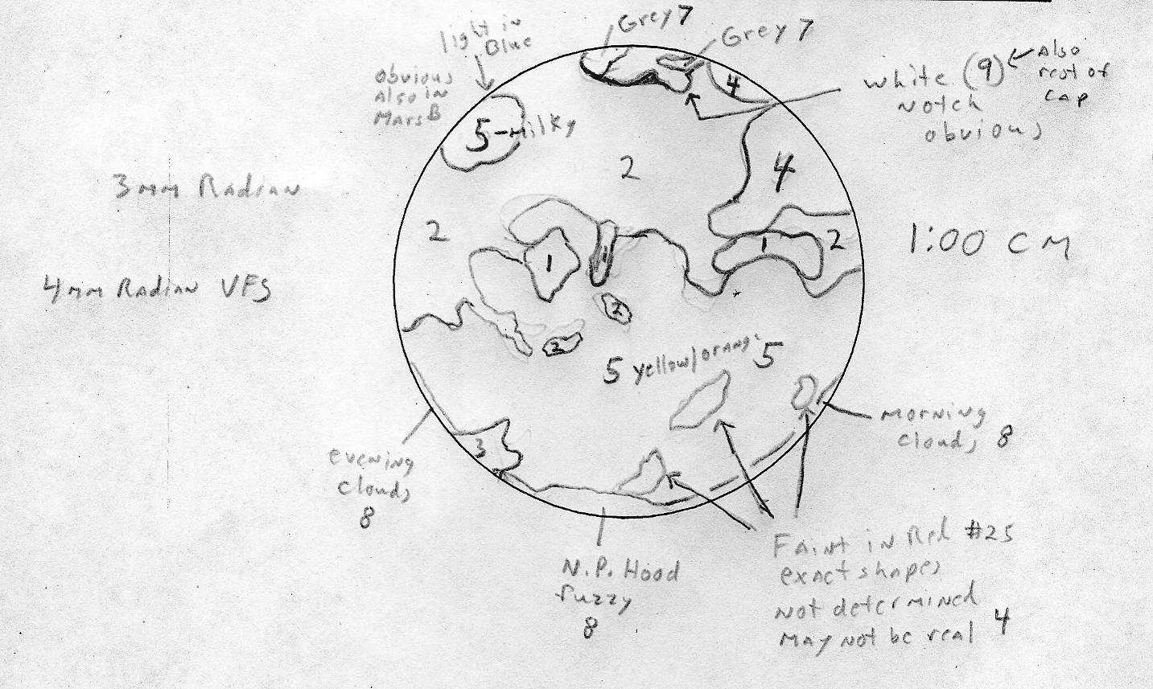
August 21, 2003 Size =24.9”,
155mm Refractor 619x

Slide 21
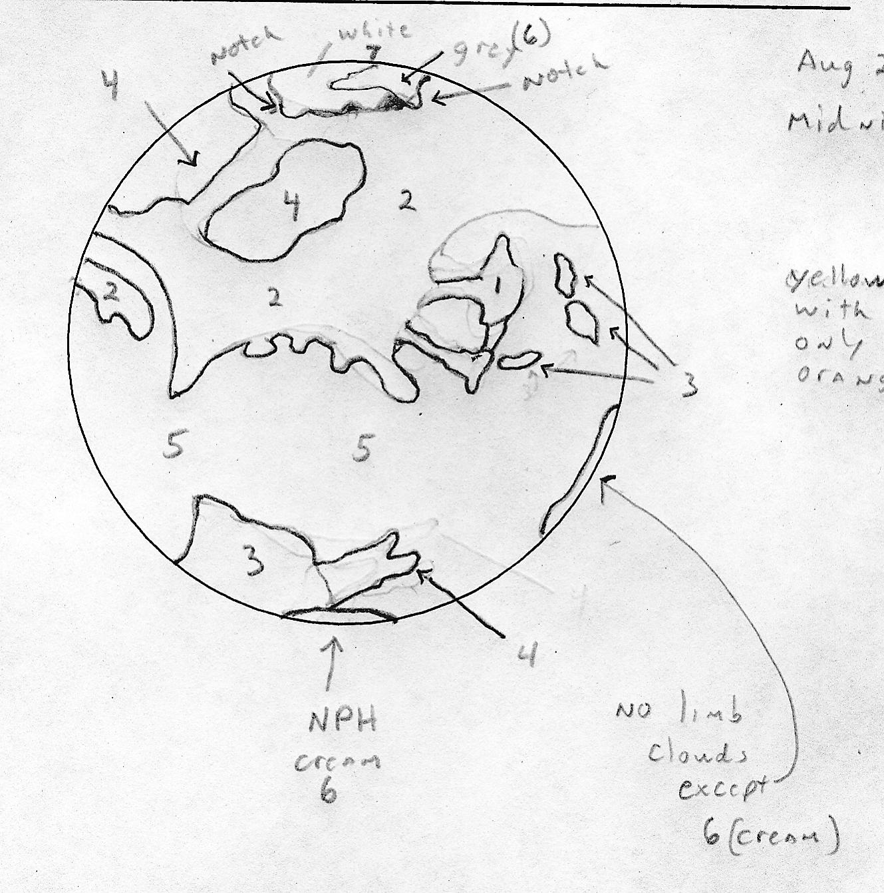
August 26, 2003 Size = 25.07”, 155mm Refractor (619x)

Slide 22
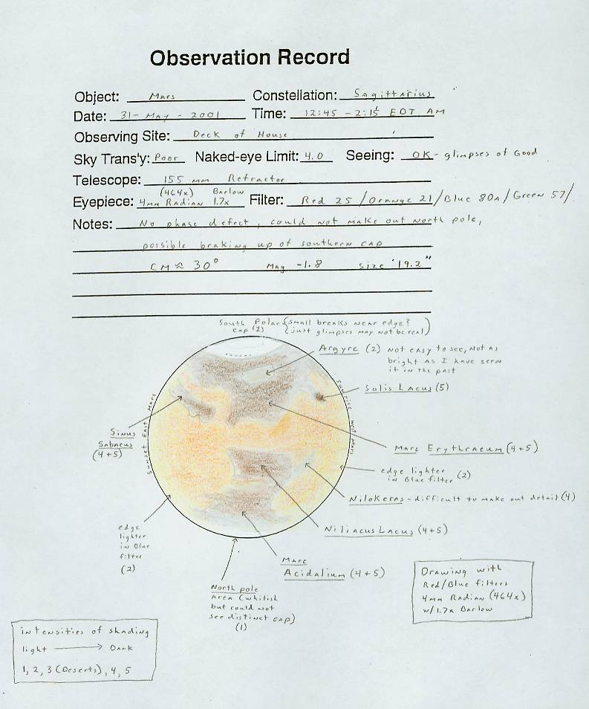
MAKE A DRAWING
Observe a while before starting the drawing -- don’t rush to draw
ALPO = 42mm disk
BAA = 50mm disk
I use = 72mm disk
Best = 3mm/arcsecond

Slide 23
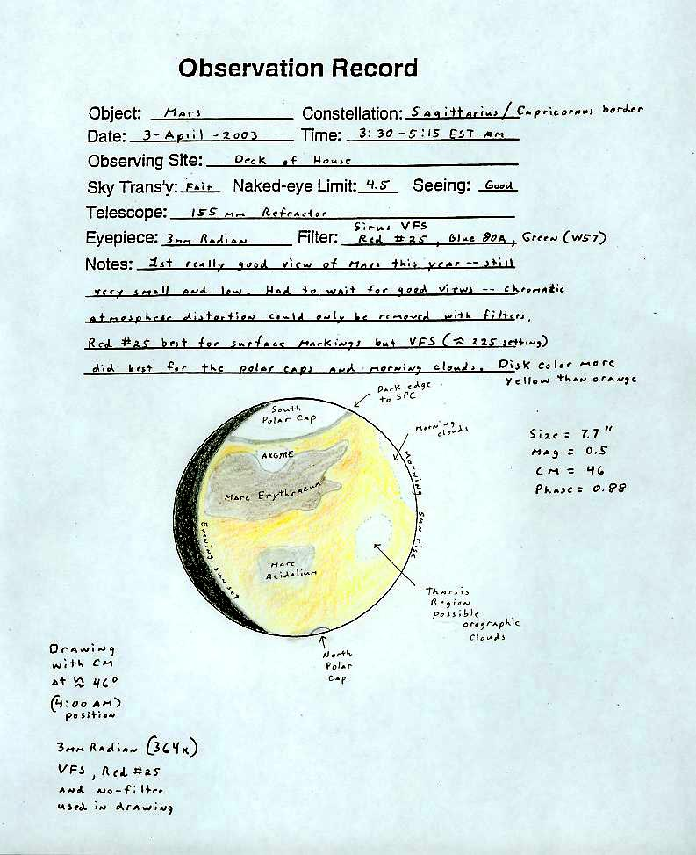
MAKE A DRAWING
Observe a while before starting the drawing -- don’t rush to draw
ALPO = 42mm disk
BAA = 50mm disk
I use = 72mm disk
Best = 3mm/arcsecond
3) Draw in Phase and PC – take notes
4) Next draw in darker areas (use a Red/Orange filter) – take notes

Slide 24
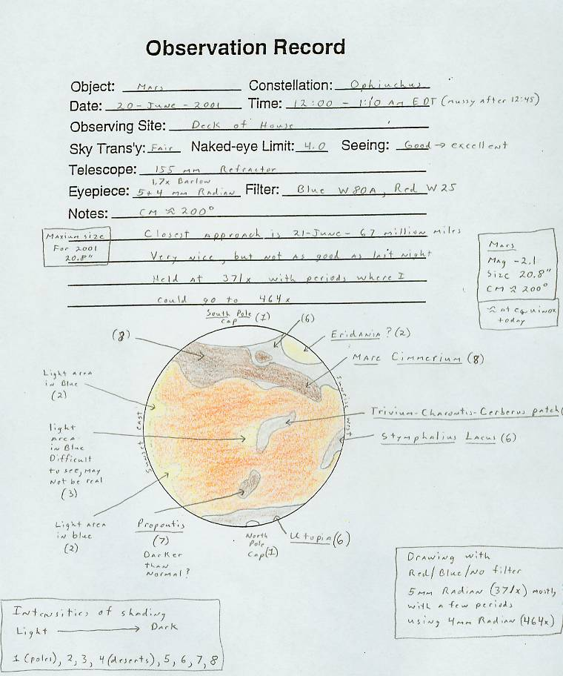
MAKE A DRAWING
Observe a while before starting the drawing -- don’t rush to draw
ALPO = 42mm disk
BAA = 50mm disk
I use = 72mm disk
Best = 3mm/arcsecond
Draw in PD and PC – take notes
Next draw in darker areas – take notes (use a Red/Orange filter )
Examine with (no filter) the red, green, blue filters make changes to drawing – take notes

Slide 25
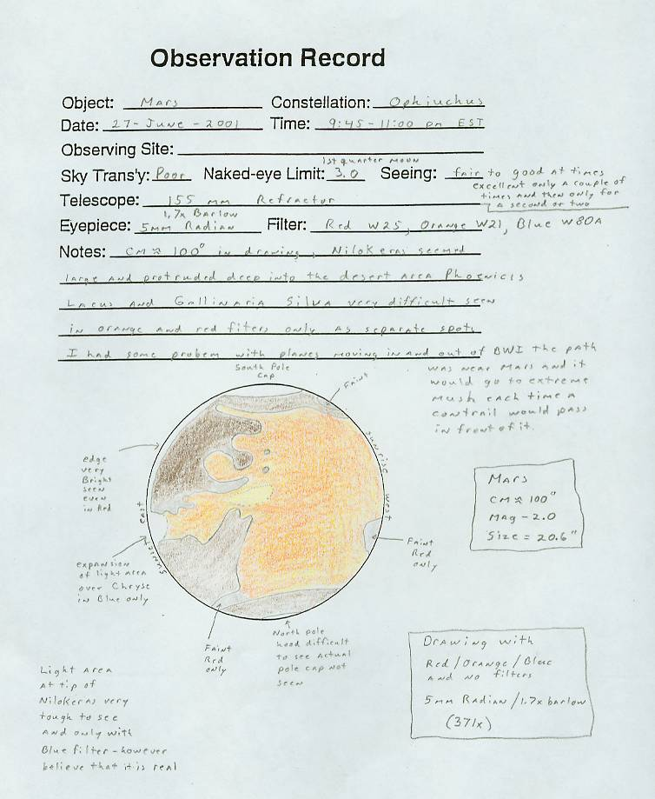
MAKE A DRAWING
Observe a while before starting the drawing -- don’t rush to draw
ALPO = 42mm disk
BAA = 50mm disk
I use = 72mm disk
Best = 3mm/arcsecond
Draw in PD and PC – take notes
4) Next draw in darker areas – take
notes (use a Red/Orange filter)
5) Examine with (no filter) then red,
green, blue filters make changes to
drawing – take notes
6) Re-draw your observations using color as soon after observing as possible

Slide 26
Additional Hints
Focus your telescope on the polar caps – not on the dark markings or the terminator
Draw only what you see not what you think should be there, remember surface features can be obscured by local or regional dust storms
Don’t try and make Mars redder than it is, determine its true color without using filters; most likely it will be more yellow than red through the telescope.
If you are going to show Mars to the general public use a Tele Vue Mars B filter or equivalent.

Slide 27
Home Work – 4 for 4
Four Not-So-Easy
Mars Targets To Focus
On For Telescopes 4-Inches or Larger in 2018

Slide 28
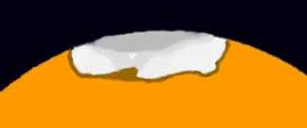
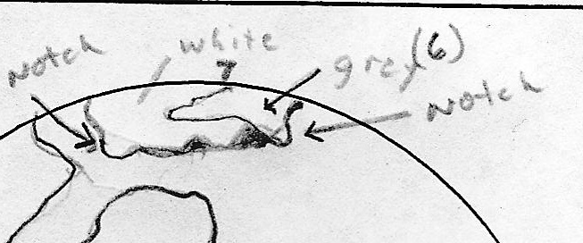
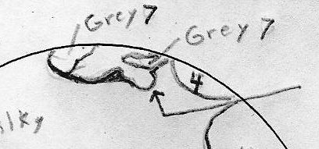
Target #1
Observe changes in South Polar Cap
MARS DRAWING OF SPC DATA CM = 3:00AM = 214 degrees Telescope = 155mm Refractor
Magnification = 619x Filters: Green #58 & Blue #80A Size = 24.1", Phase = 98%
Magnitude = -2.6
12 August 2003, 1:00 am to 3:00 am (Local Time)
August 21, 2003 August 26, 2003

Slide 29
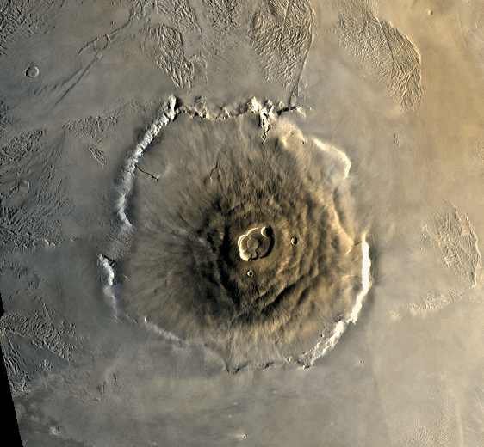
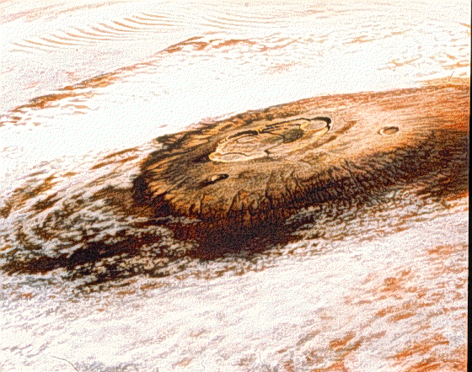
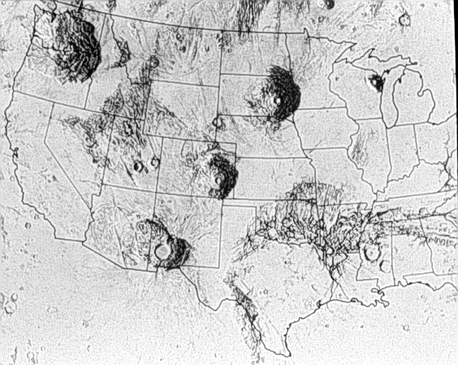
Prime Target 2 Find the Snows of Mt. Olympus
Four of the Tharsis Plateau volcanoes are truly giants, of which Olympus Mons is the biggest (420 miles across and 15 miles high).
Named the Snows of Mt. Olympus before space visits because of the white clouds that form above the mountain – best seen a few hours before sunset on Mars.
With a 6% slope none of the volcanoes cast a shadow that can be seen in telescopes
Only chance of seeing the volcanoes proper are during a dust storm when contrast is great (appear as dark spots).

Slide 30
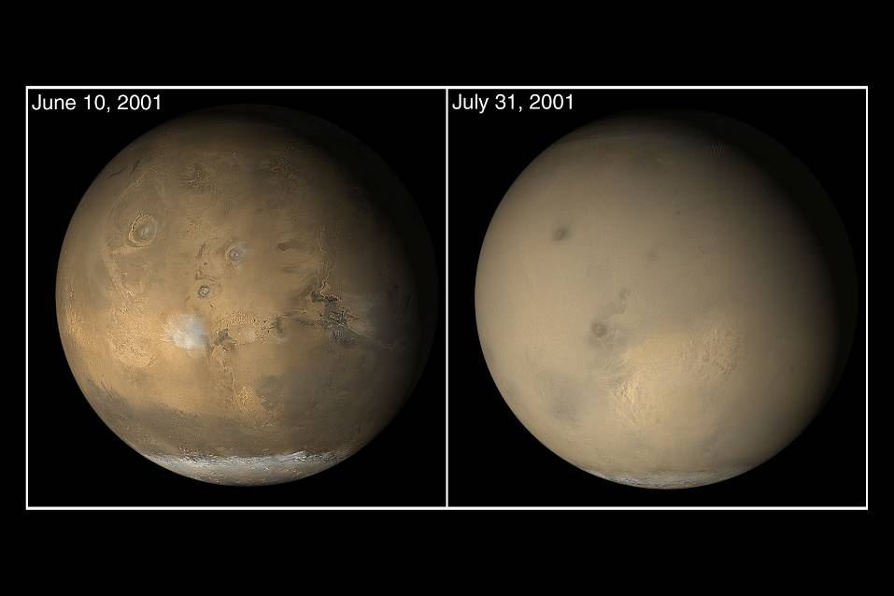
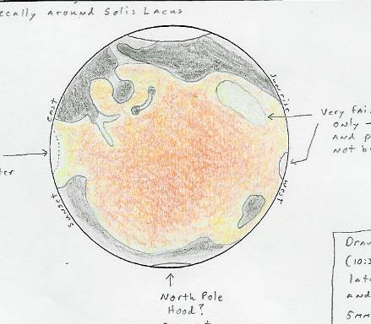
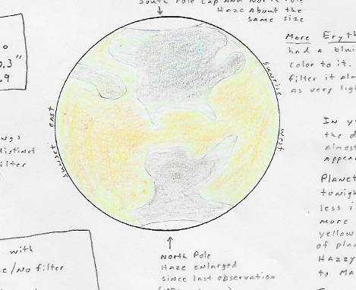
Prime Target 3
Observe Local/Global Dust Storms
Global level dust storms are most likely at perihelion but local dust storms are unpredictable and should be looked for throughout the Mars opposition.
Dust Storms (Bright in Red; Faint in Yellow)
25 – JUNE – 2001 O2 – JULY - 2001

Slide 31
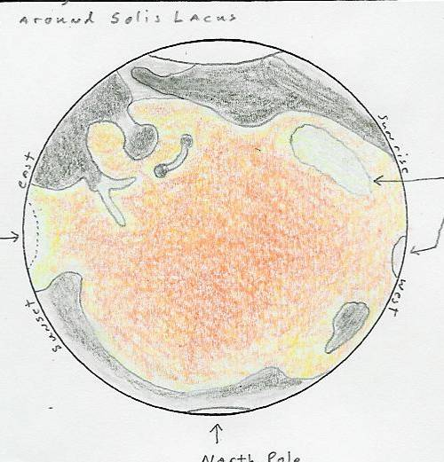
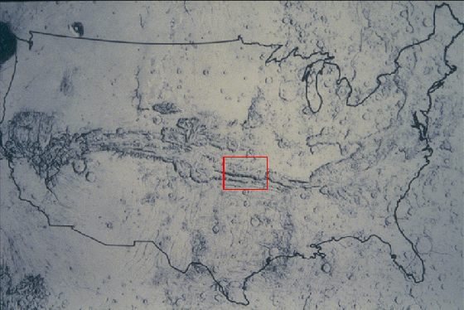
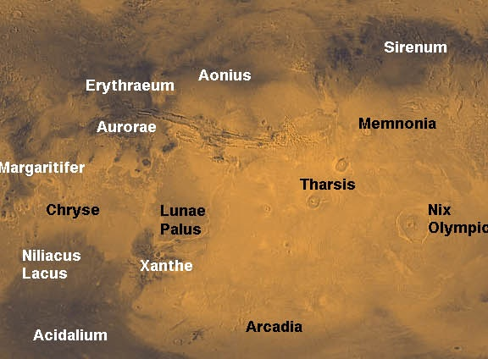
Prime Target 4 – Find Agnathadaemon (Valles Marineris)
1/6 circumference of Mars
3,000 miles long, 6 miles deep, up to 120 miles wide
Formed when the lifting of the Tharsis Plateau

Slide 32
Mars so far in 2018

Slide 33
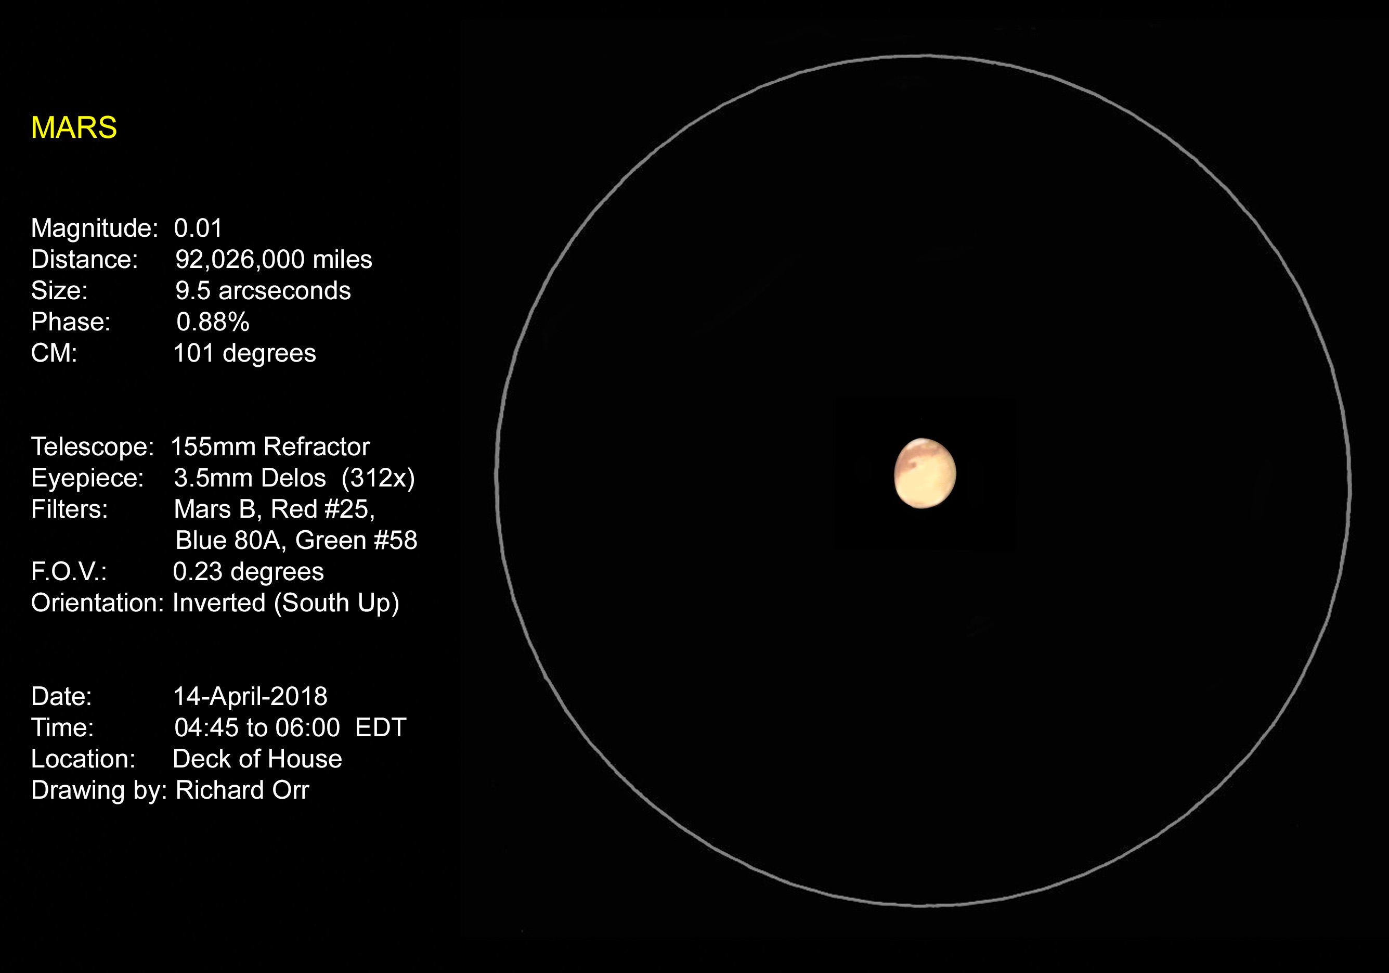

Slide 34
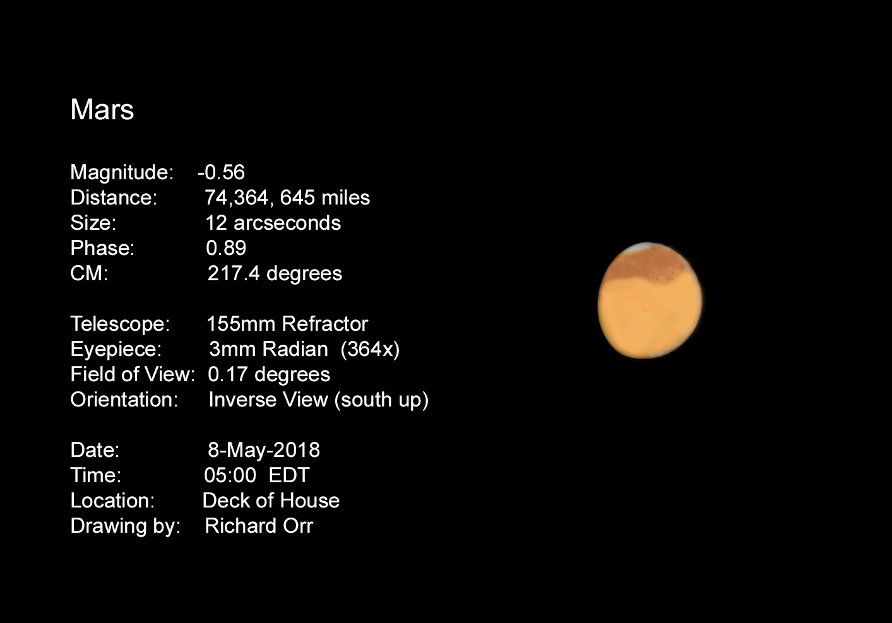

Slide 35
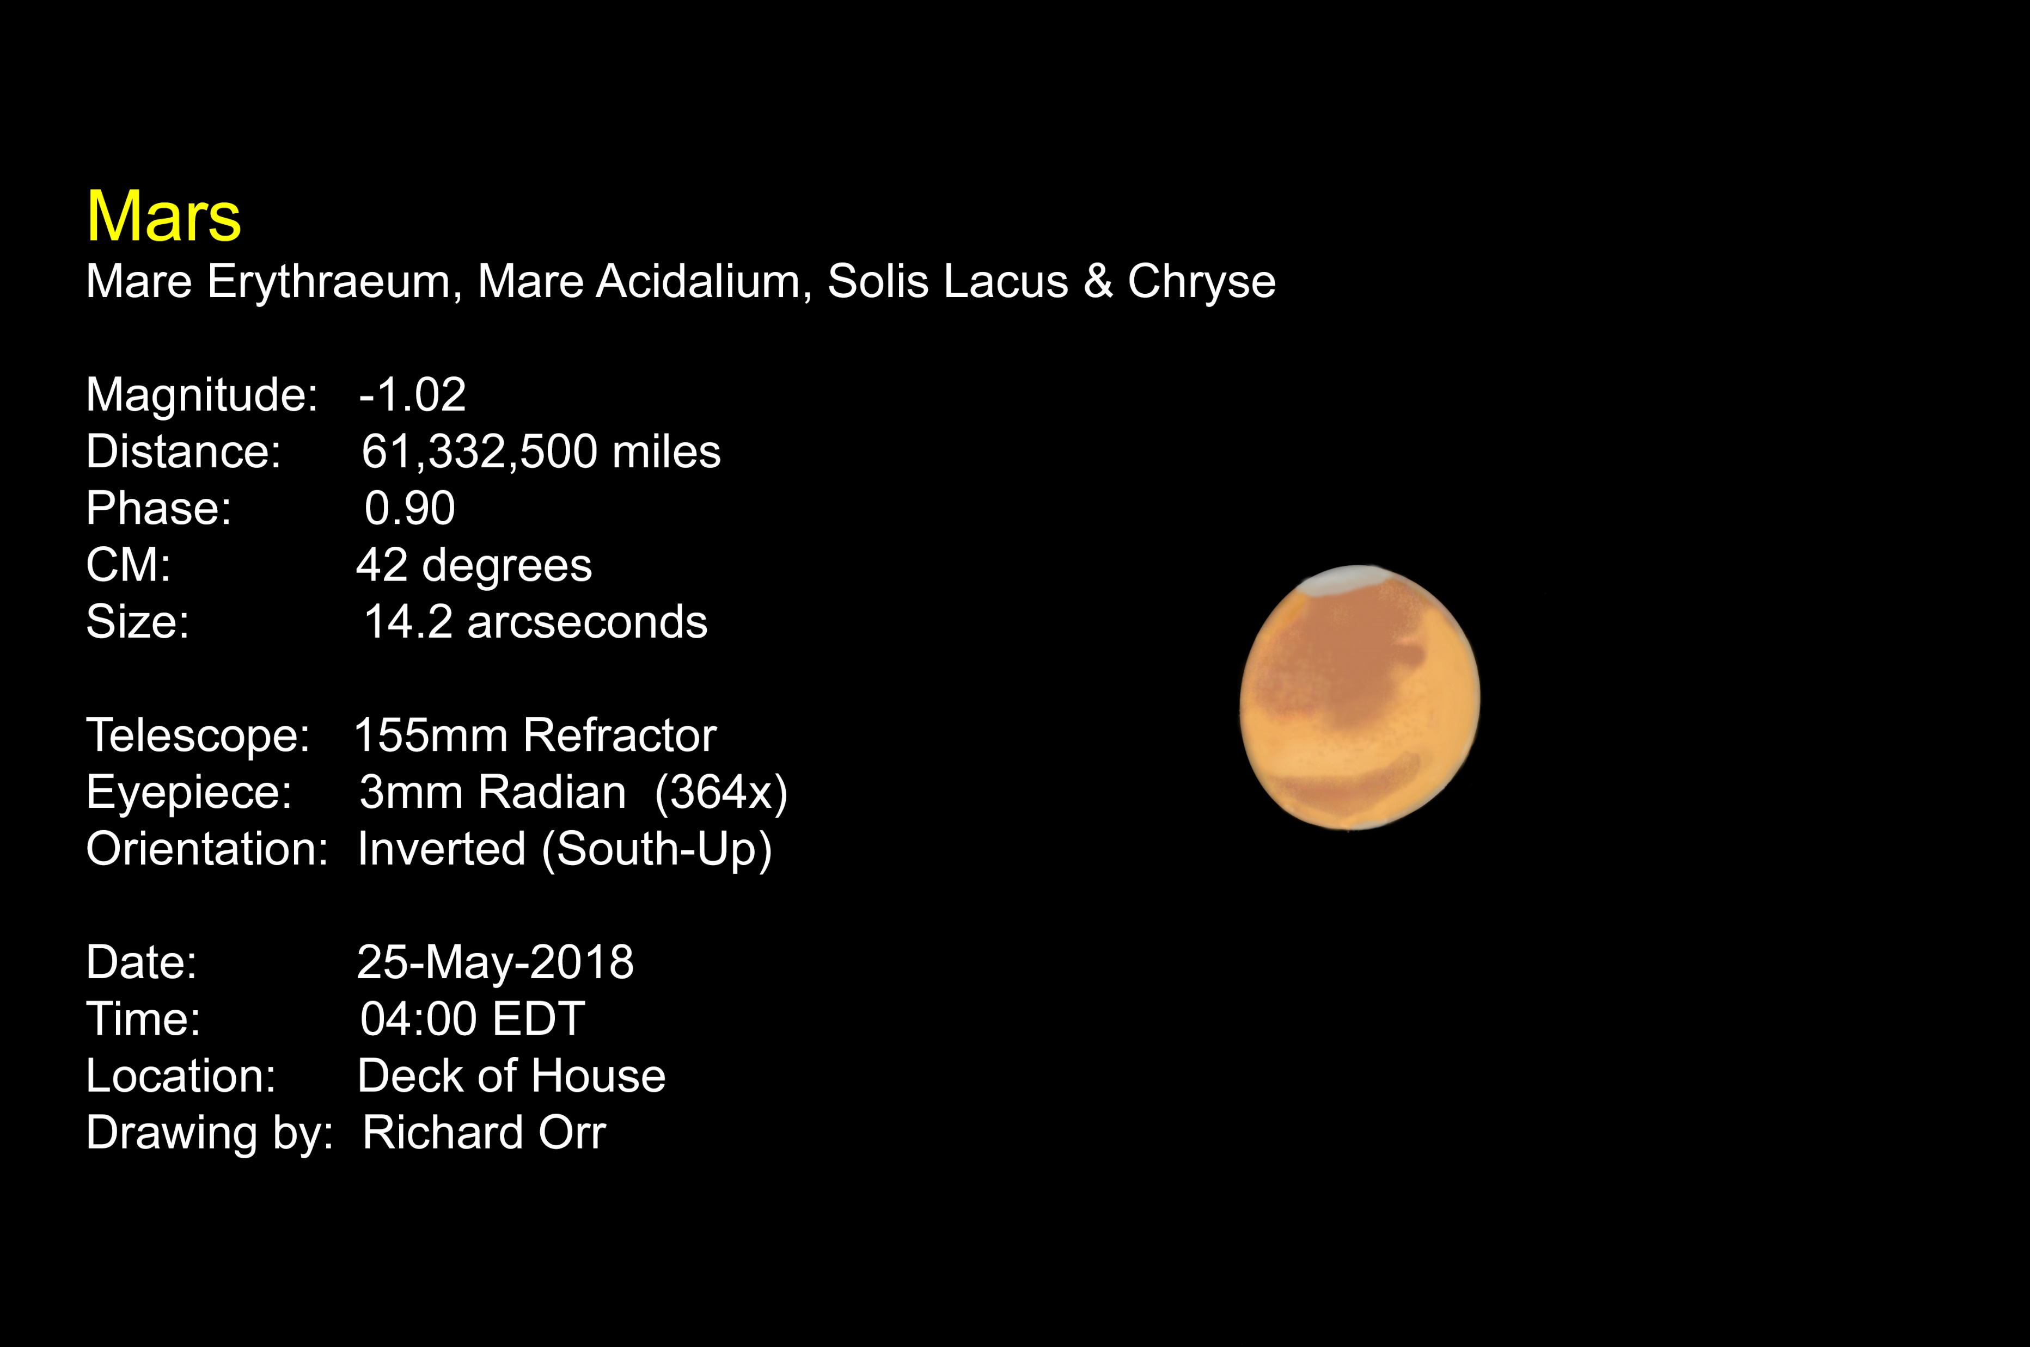

Slide 36
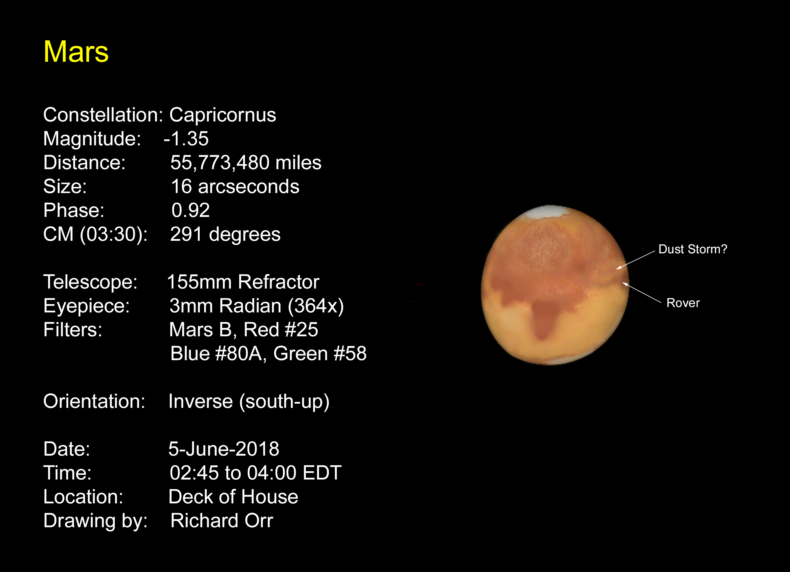

Slide 37
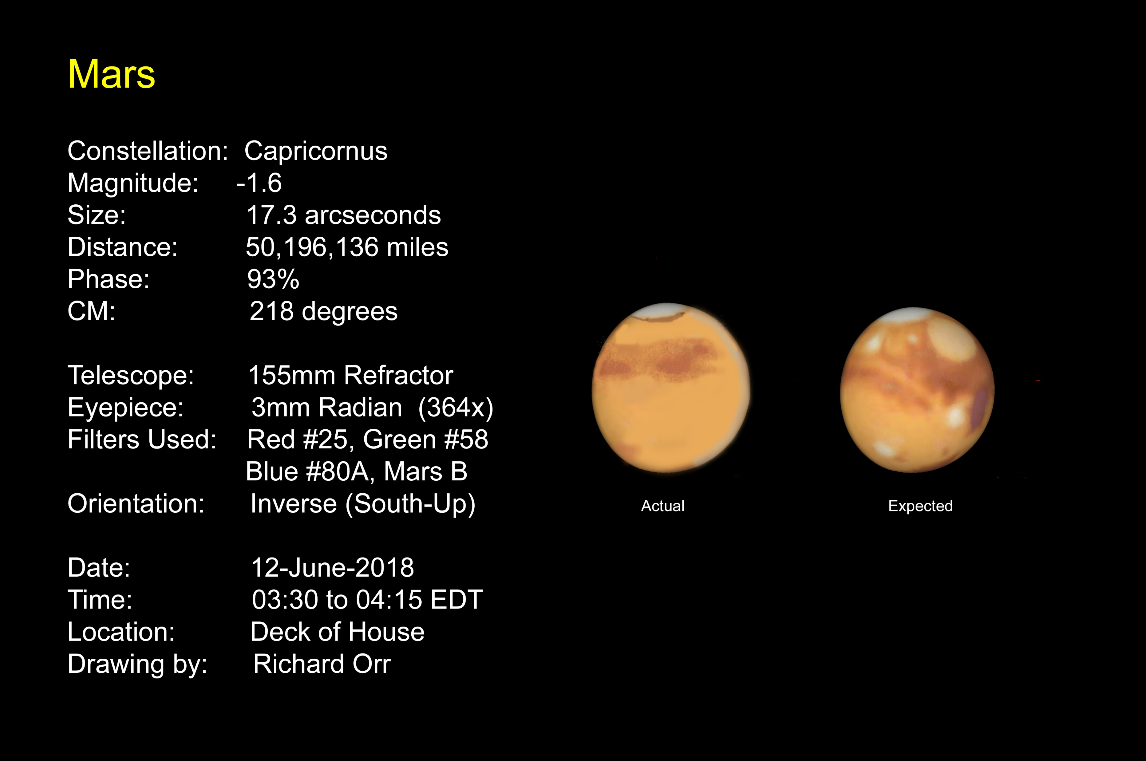

Slide 38
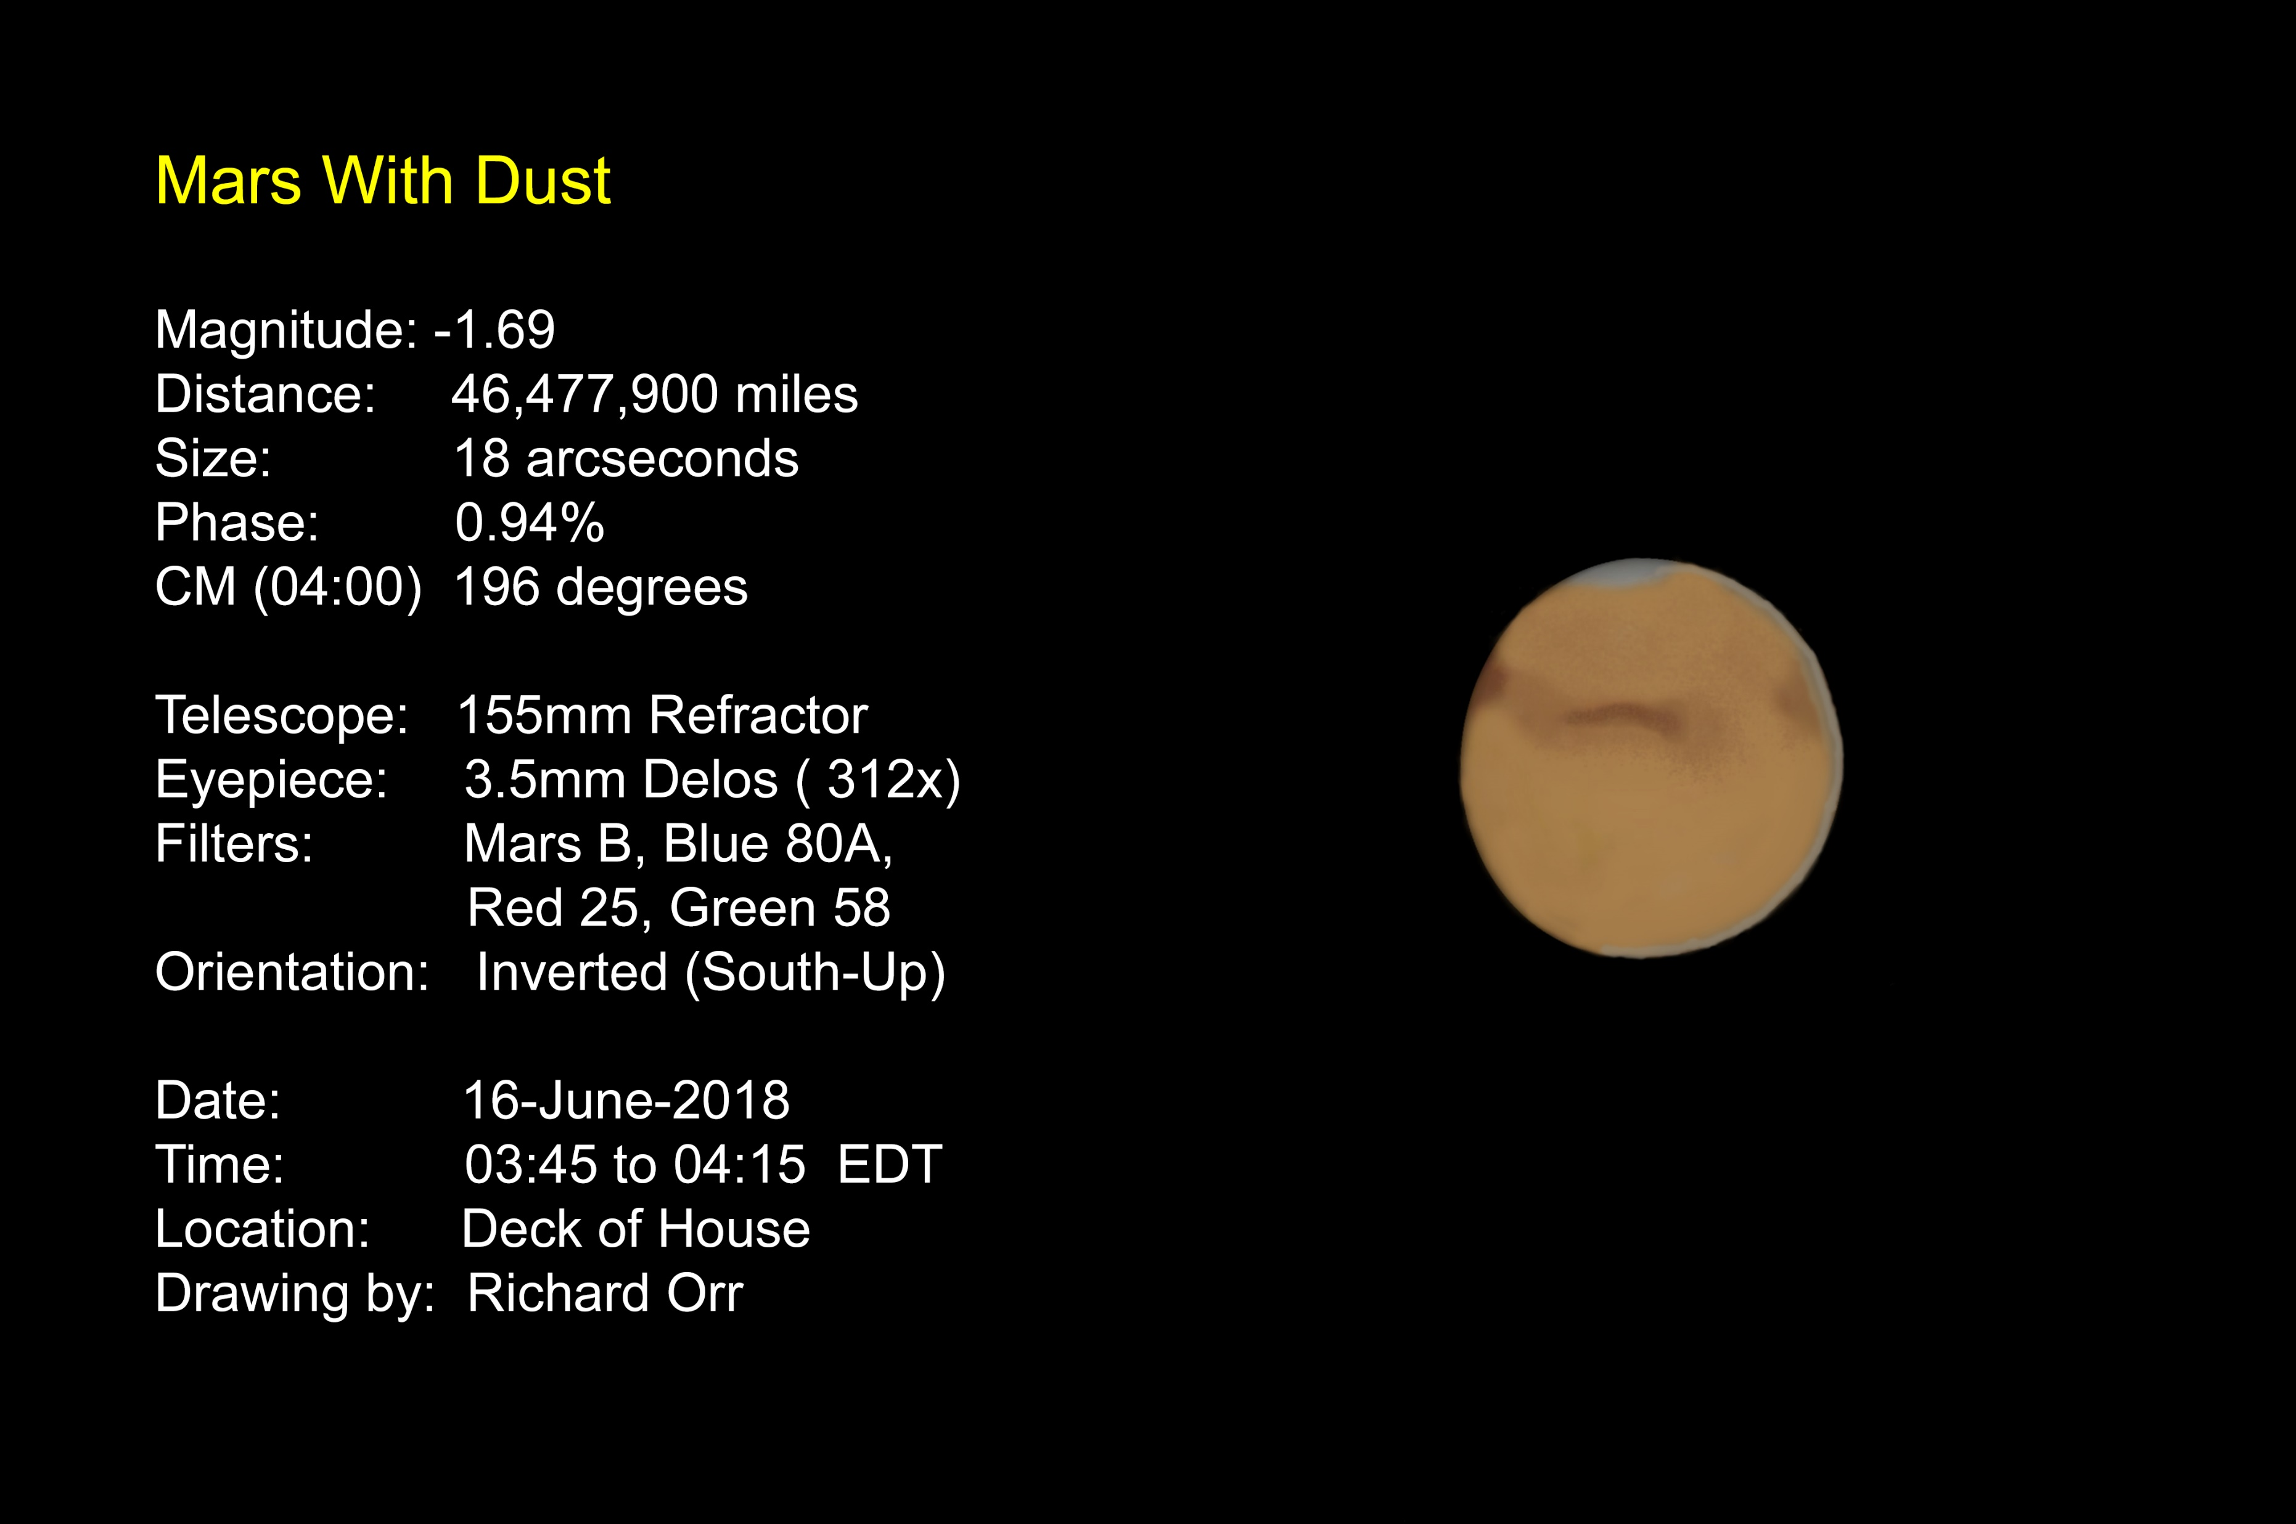

Slide 39
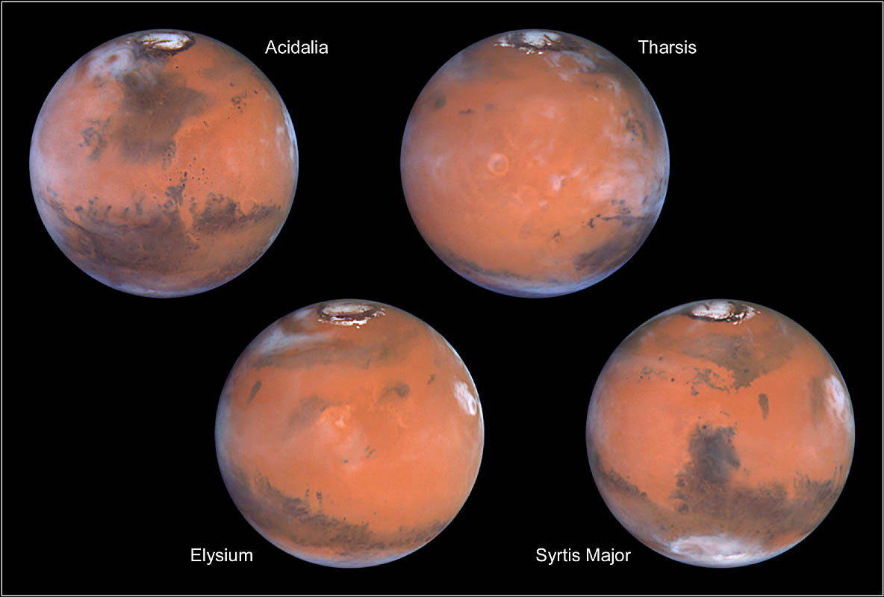
Mars as Hubble sees it
Once you look at Mars – You will never think of red light in the same way!

